Slide 1
Interval Estimation
Mr. Sunanda Das
Assistant Professor, Dept. of CSE, KUET

Slide 2
Interval Estimation
Interval estimation is the use of sample data to calculate an interval of possible values of an unknown population parameter.
This is in contrast to point estimation, which gives a single value.
The most prevalent forms of interval estimation are:
confidence intervals
credible intervals

Slide 3
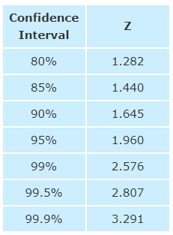
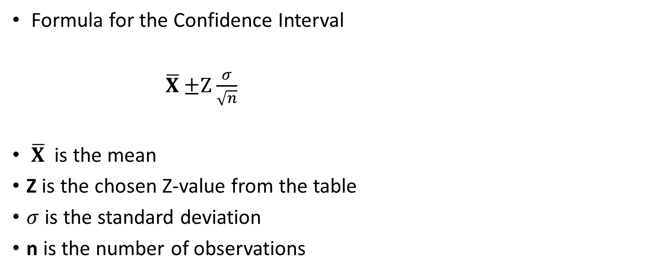
Confidence Intervals
Formula for the Confidence Interval
$\overline{X}$ $±Z$ $\frac{σ}{\sqrt{n}}$
$\overline{X}$is the mean
Z is the chosen Z-value from the table
$σ$ is the standard deviation
n is the number of observations

Slide 4
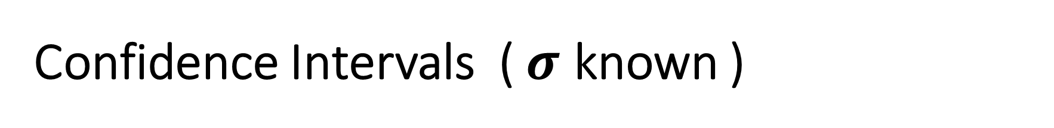
Confidence Intervals ( $σ$ known )
A Confidence Interval is a range of values we are fairly sure our true value lies in.
We measure the heights of 40 randomly chosen men, and get a mean height of 175cm, We also know the standard deviation of men's heights is 20cm.
The 95% Confidence Interval = 175cm ± 6.2cm

Slide 5

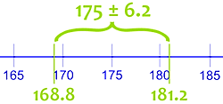

from 168.8cm to 181.2cm

Slide 6
For finding the standard error of the mean we need
The population standard deviation
The sample size
If we do not know the population standard deviation we have to estimate it.

Slide 7
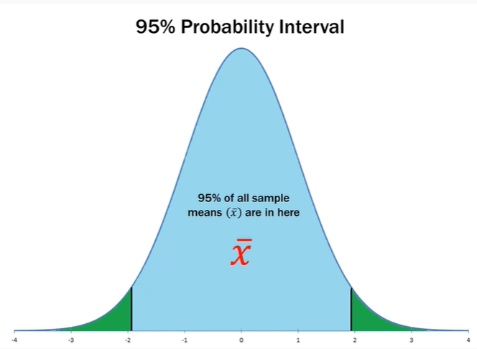
For standard normal curve
Area under the curve = 1
Probability under the curve = 1
The distribution of many sample
means in a given sample size.

Slide 8
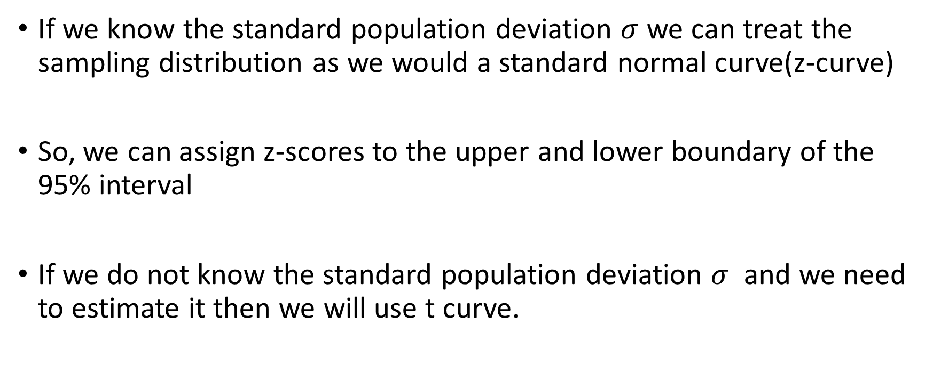
If we know the standard population deviation $σ$ we can treat the sampling distribution as we would a standard normal curve(z-curve)
So, we can assign z-scores to the upper and lower boundary of the 95% interval
If we do not know the standard population deviation $σ$ and we need to estimate it then we will use t curve.

Slide 9
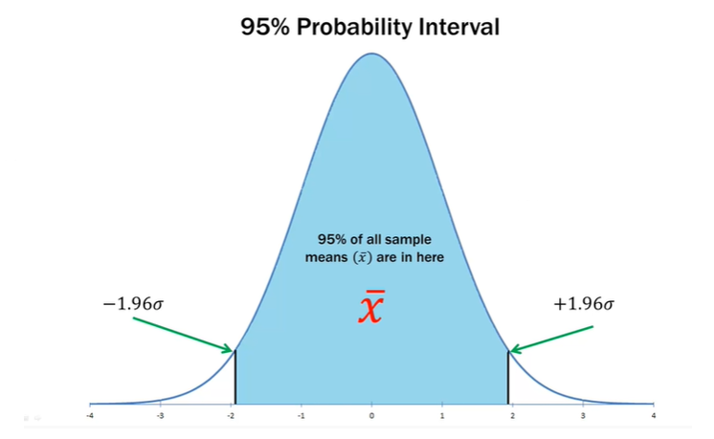

Slide 10
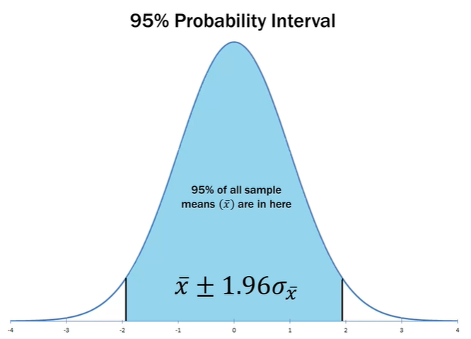

Slide 11
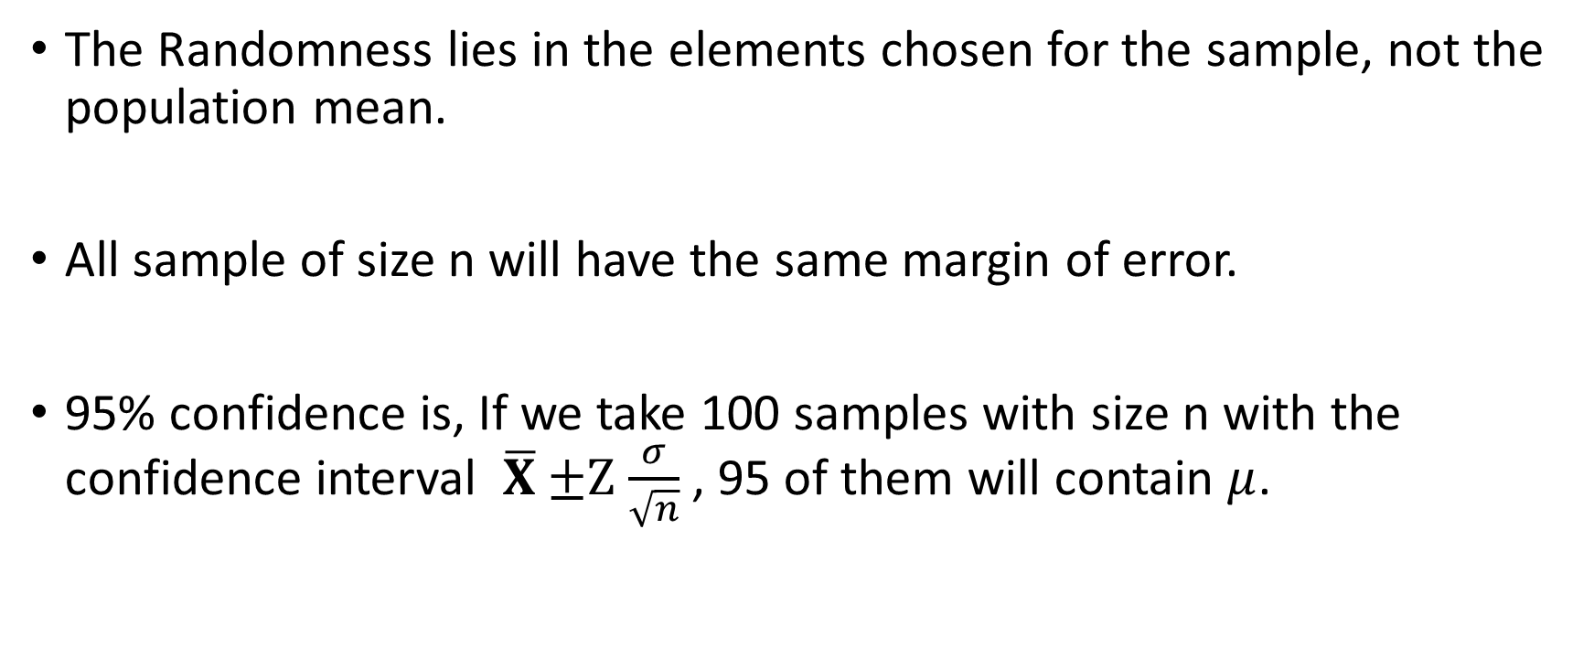
The Randomness lies in the elements chosen for the sample, not the population mean.
All sample of size n will have the same margin of error.
95% confidence is, If we take 100 samples with size n with the confidence interval $\overline{X}$ $±Z$ $\frac{σ}{\sqrt{n}}$ , 95 of them will contain $μ$.

Slide 12


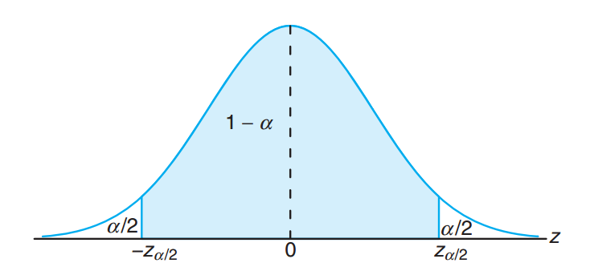
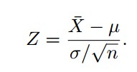



Estimating the Mean
The sample mean $\overline{x}$ will be used as a point estimate for the population mean μ.

Slide 13

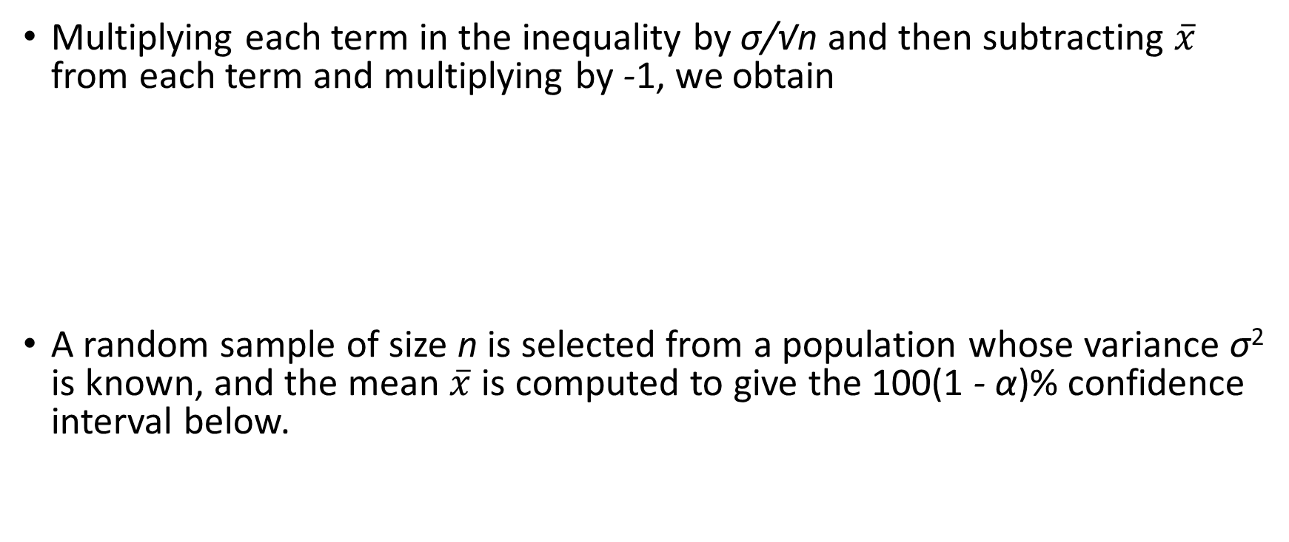
Multiplying each term in the inequality by σ/√n and then subtracting $\overline{x}$ from each term and multiplying by -1, we obtain
A random sample of size n is selected from a population whose variance σ² is known, and the mean $\overline{x}$ is computed to give the 100(1 - α)% confidence interval below.

Slide 14
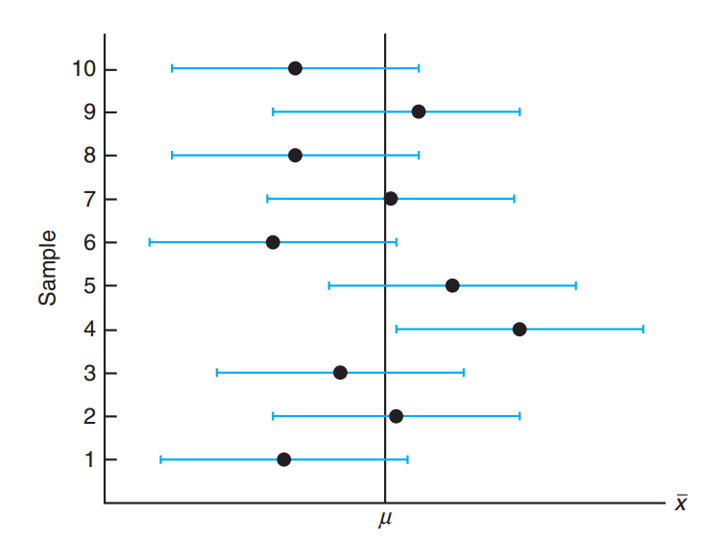


Slide 15
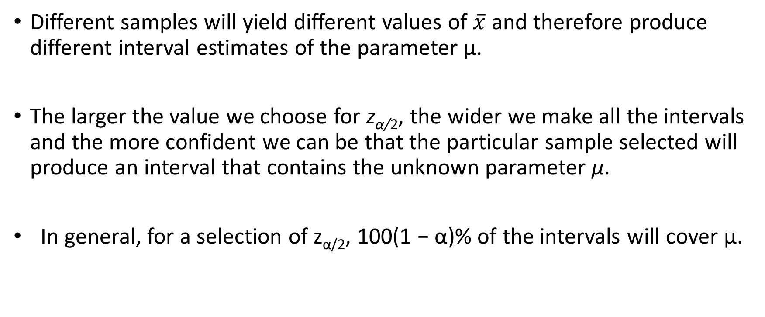
Different samples will yield different values of $\overline{x}$ and therefore produce different interval estimates of the parameter μ.
The larger the value we choose for z_{α/2}, the wider we make all the intervals and the more confident we can be that the particular sample selected will produce an interval that contains the unknown parameter μ.
In general, for a selection of z_{α/2}, 100(1 − α)% of the intervals will cover μ.

Slide 16
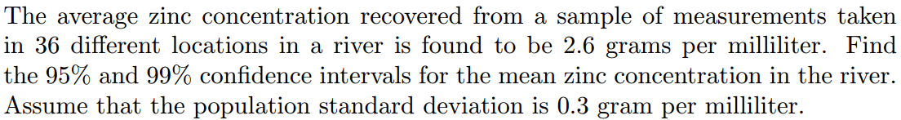
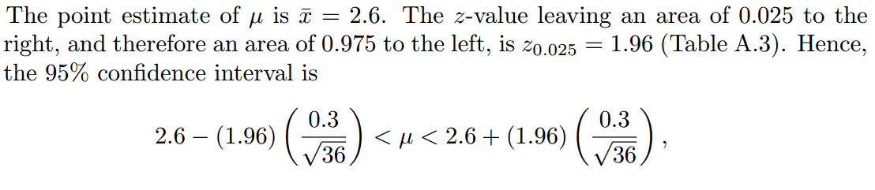

Slide 17
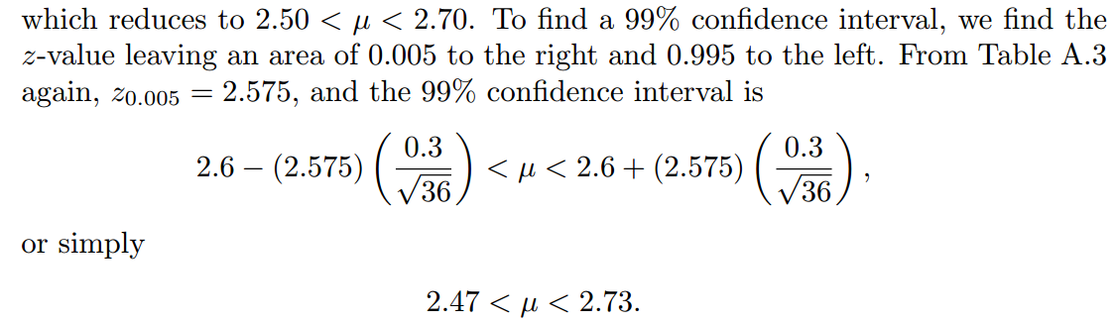

Slide 18
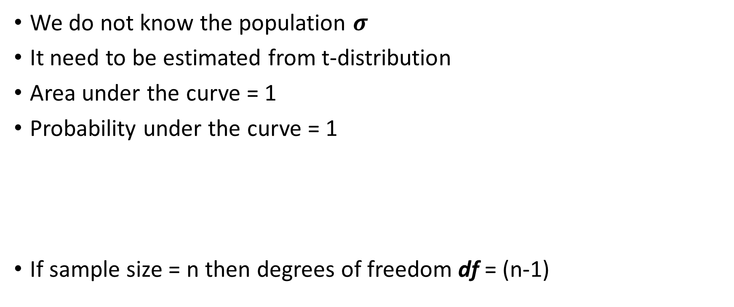
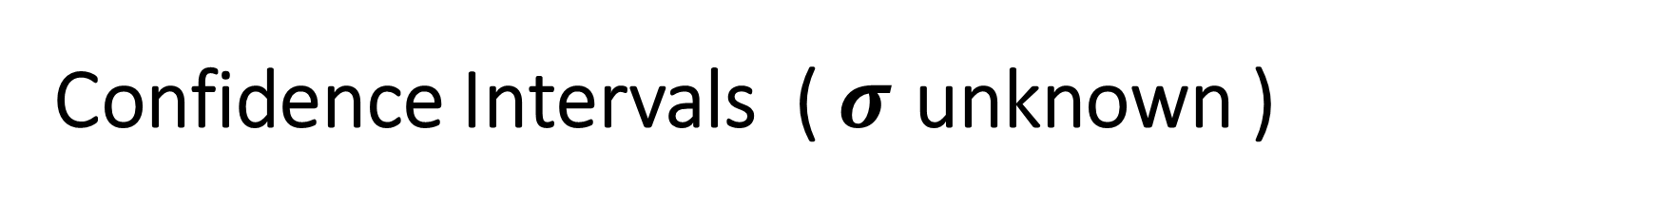
Confidence Intervals ( $σ$ unknown )
We do not know the population $σ$
It need to be estimated from t-distribution
Area under the curve = 1
Probability under the curve = 1
If sample size = n then degrees of freedom df = (n-1)

Slide 19
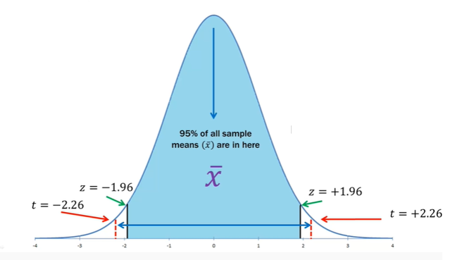
T-distribution

Slide 20
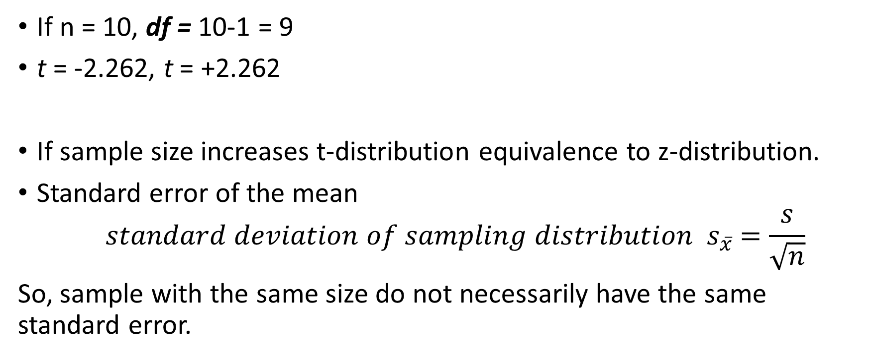
If n = 10, df = 10-1 = 9
t = -2.262, t = +2.262
If sample size increases t-distribution equivalence to z-distribution.
Standard error of the mean
$${ standard deviation of sampling distribution s}_{\overline{x}} =\frac{s}{\sqrt{n}}$$
So, sample with the same size do not necessarily have the same standard error.

Slide 21

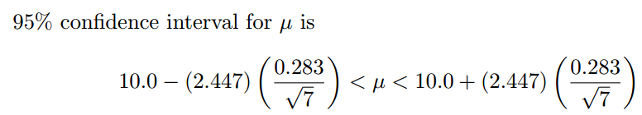

The contents of seven similar containers of sulfuric acid are 9.8, 10.2, 10.4, 9.8, 10.0, 10.2, and 9.6 liters. Find a 95% confidence interval for the mean contents of All such containers, assuming an approximately normal distribution.

Slide 22
Prediction Intervals
Use the observed data to predict a new observation.
A prediction interval is an estimate of an interval in which a future observation will fall, with a certain probability.
For example, for a 95% prediction interval of [5, 10], you can be 95% confident that the next new observation will fall within this range.

Slide 23

Prediction Interval of a Future Observation, σ² Known
For a normal distribution of measurements with unknown mean μ and known variance σ², a 100(1 - α)% prediction interval of a future observation x₀ is

Slide 24

Prediction Interval of a Future Observation, σ² unKnown
For a normal distribution of measurements with unknown mean μ and unknown variance σ², a 100(1 − α)% prediction interval of a future observation x₀ is

Slide 25

Due to the decrease in interest rates, the First Citizens Bank received a lot of mortgage applications. A recent sample of 50 mortgage loans resulted in an average loan amount of $257,300. Assume a population standard deviation of $25,000. For the next customer who fills out a mortgage application, find a 95% prediction interval for the loan amount.

Slide 26

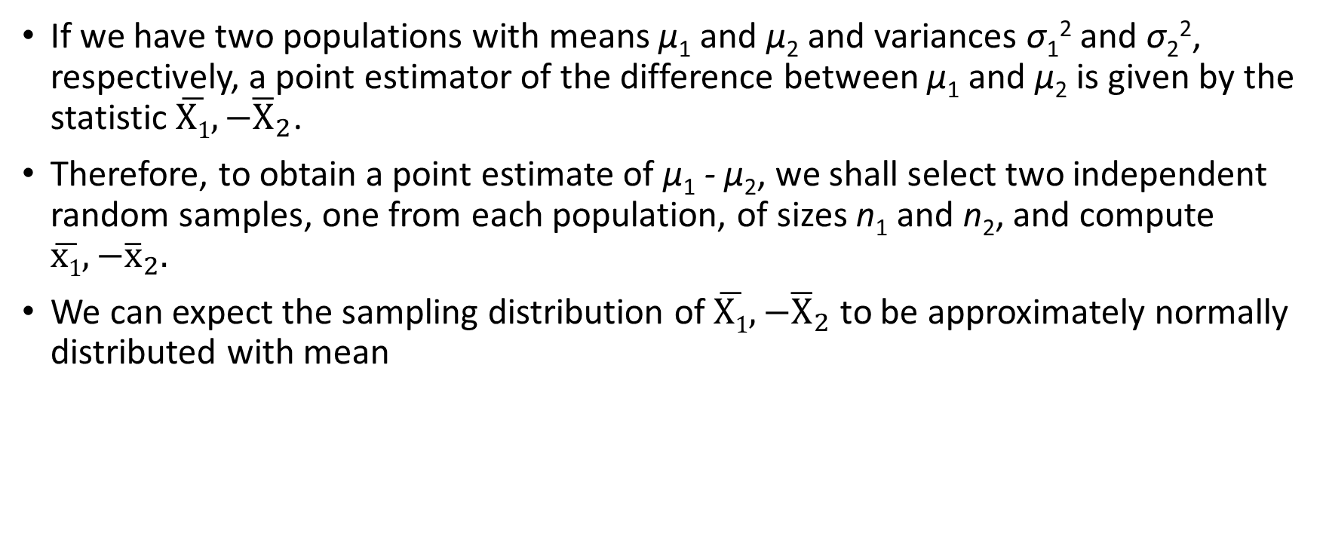
Two Samples: Estimating the Difference between Two Means
If we have two populations with means μ₁ and μ₂ and variances σ₁² and σ₂², respectively, a point estimator of the difference between μ₁ and μ₂ is given by the statistic $\overline{X1},−{\overline{X}}_{2}$.
Therefore, to obtain a point estimate of μ₁ - μ₂, we shall select two independent random samples, one from each population, of sizes n₁ and n₂, and compute $\overline{x1},−{\overline{x}}_{2}.$
We can expect the sampling distribution of $\overline{X1},−{\overline{X}}_{2}$ to be approximately normally distributed with mean

Slide 27

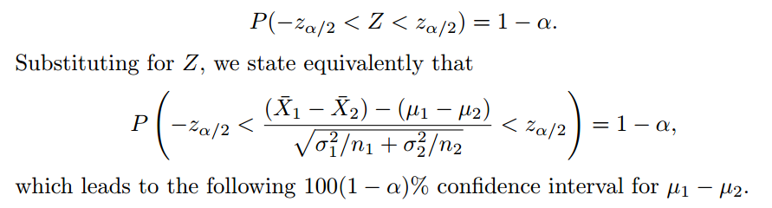
We can assert with a probability of 1 − α that the standard normal variable

Slide 28
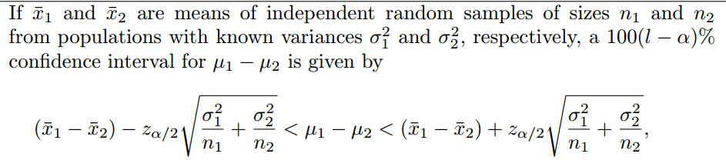
Confidence Interval for μ₁ − μ₂, σ₁² and σ₂² Known

Slide 29
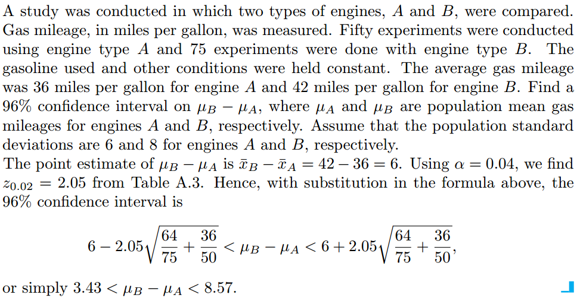

Slide 30
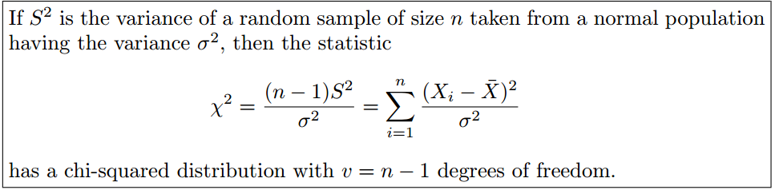
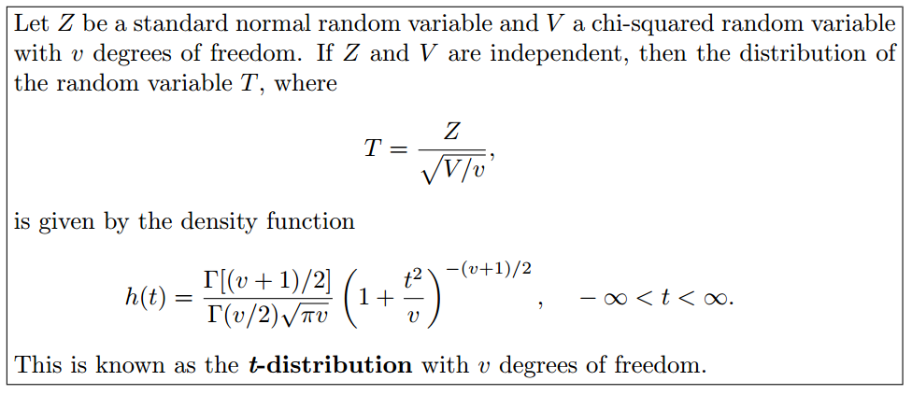

Slide 31
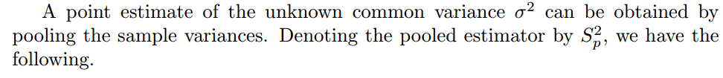


Slide 32
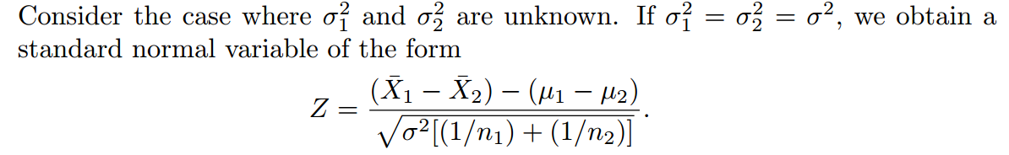
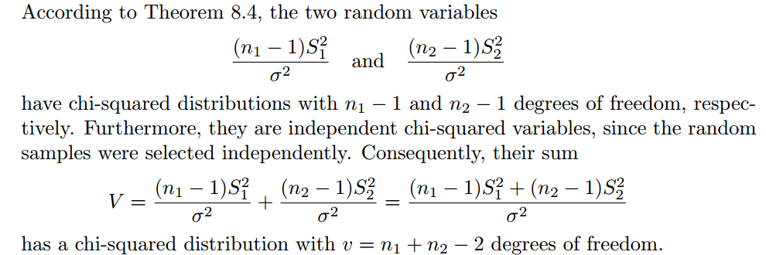
Variances Unknown but Equal

Slide 33
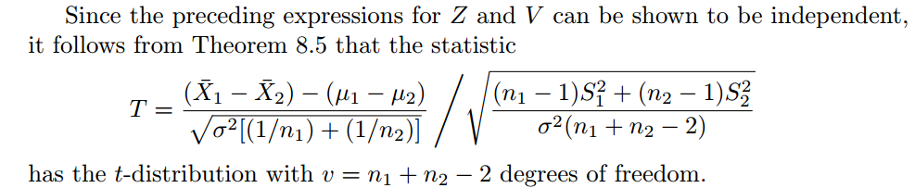
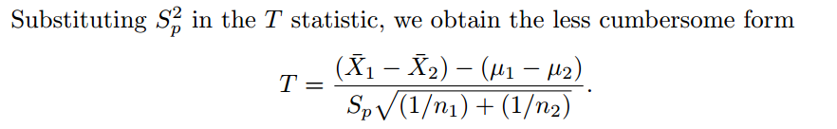

Slide 34
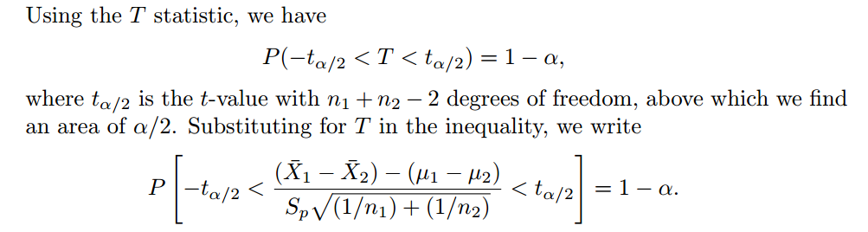

Slide 35
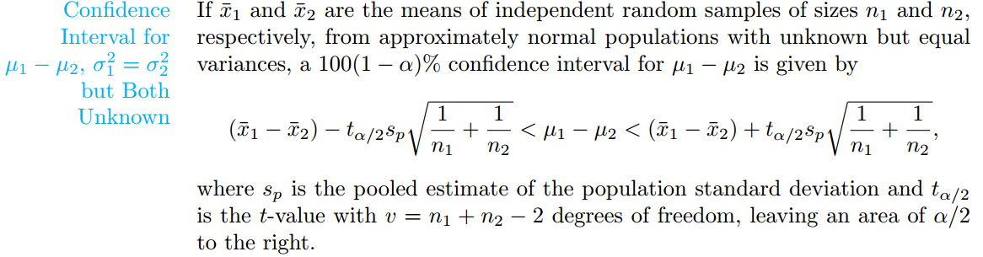

Slide 36
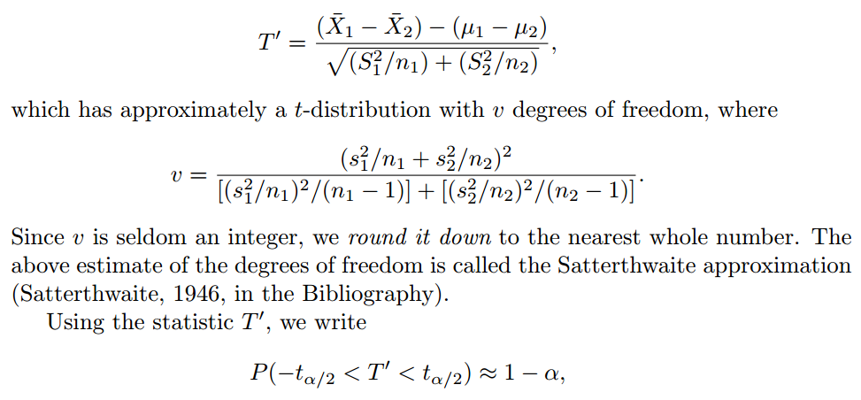
Unknown and Unequal Variances

Slide 37
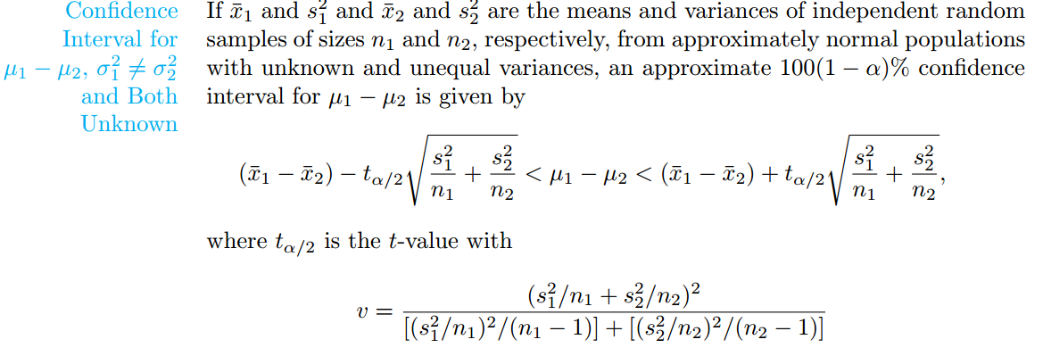

Slide 38
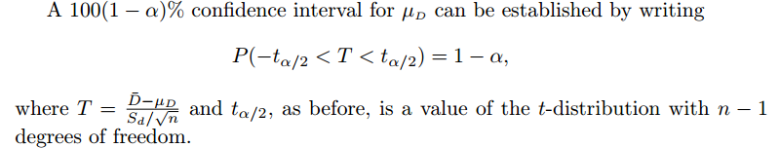
Paired Observations
we shall consider estimation procedures for the difference of two means when the samples are not independent and
the variances of the two populations are not necessarily equal.

Slide 39
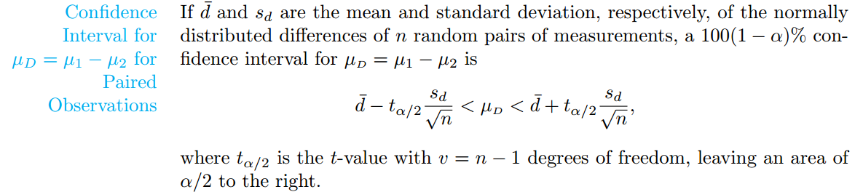

Slide 40
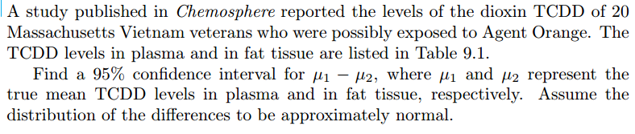
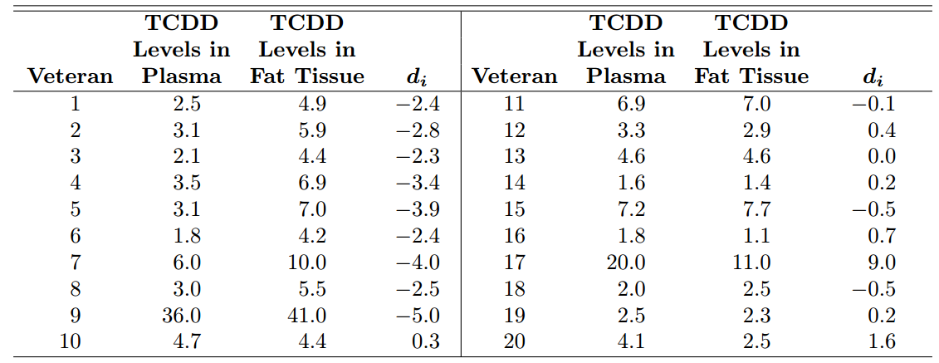

Slide 41
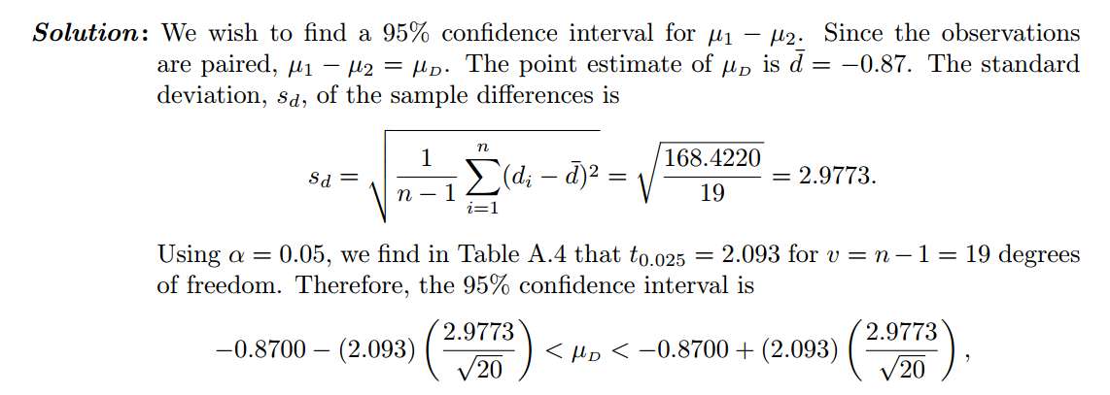

Slide 42
References
https://en.wikipedia.org/wiki/Interval_estimation
https://www.mathsisfun.com/data/confidence-interval.html
Probability & Statistics for Engineers & Scientists by Ronald E. Walpole, Raymond H. Myers, Sharon L. Myers, Keying Ye
https://en.wikipedia.org/wiki/Prediction_interval
https://statisticsbyjim.com/glossary/prediction-intervals/

